Slide 1
Neural Network learning Captain Comic
Felix Burr, Karsten Kögel

Slide 2
Inhalt
  Captain Comic
  NEAT
  Between game and net
  Results
  Difficulties
  Discussion

Slide 3
Captain Comic

Slide 4
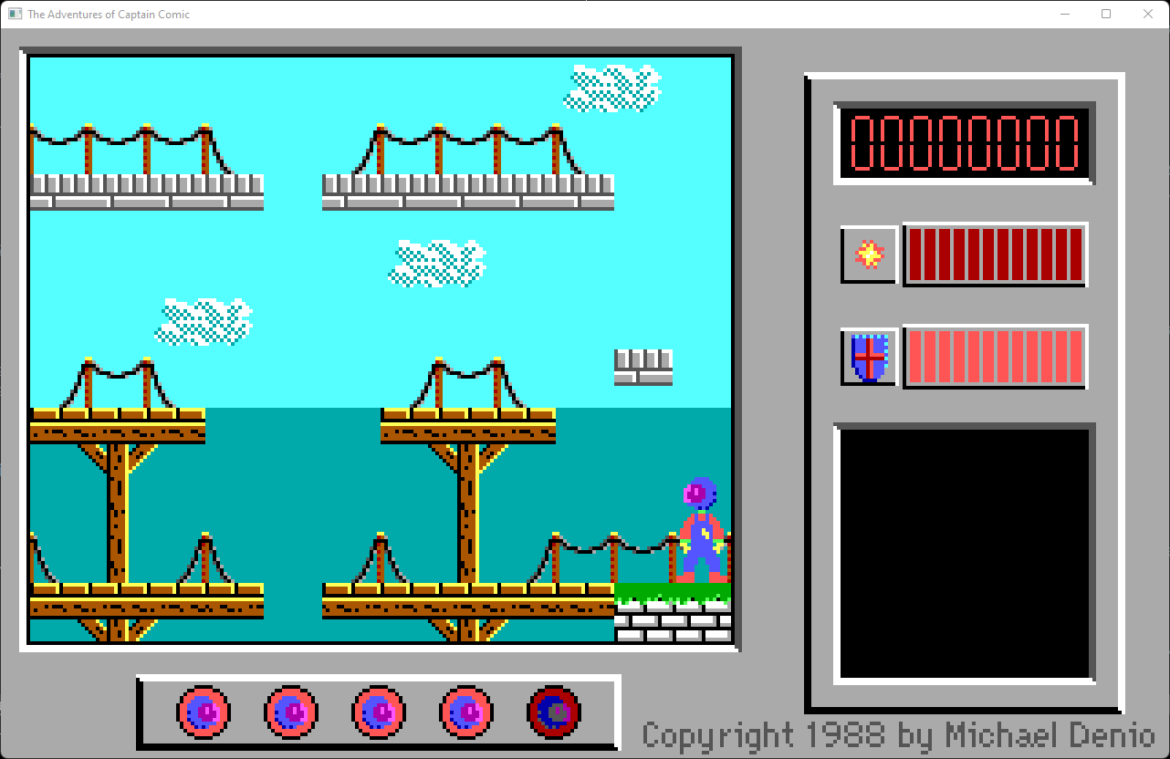
Gameplay
Platforming with enemies
Branching Worldmap
8 kinds of pickups, most needed to succeed

Slide 5
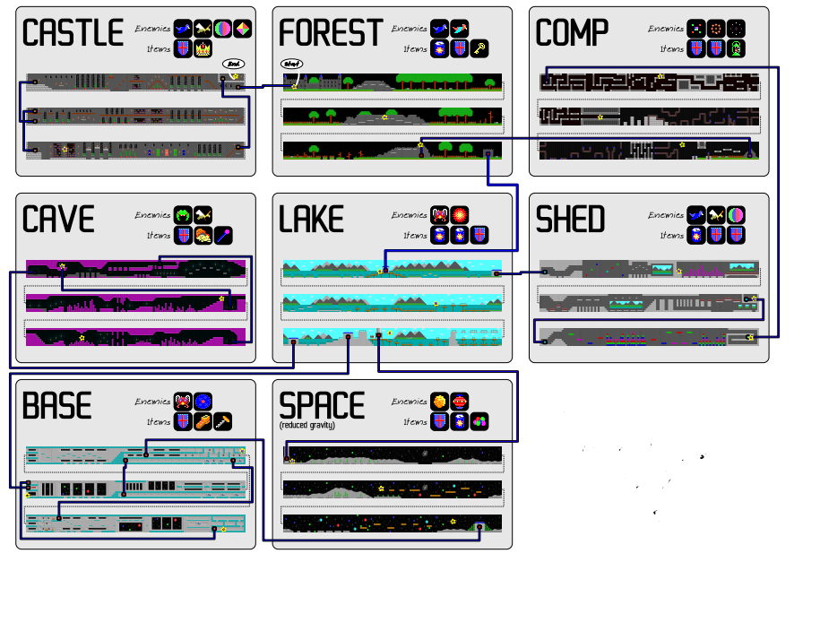
Captain comic
https://github.com/StevenVanAcker/the-adventures-of-captain-comic

Slide 6
NEAT (NeuroEvolution of Augmenting Topologies)

Slide 7
Neat Structure
Builds random minimal net
  Applies mutation to: nodes, connections, weights
Seperates into species
Calculates fittness
Crossbreeds intra-species

Slide 8
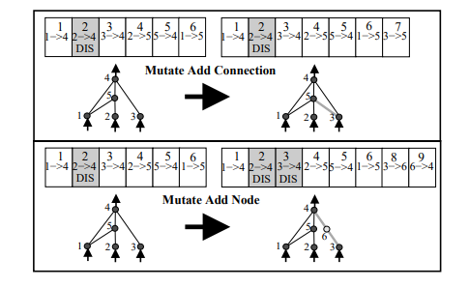
Mutations
http://nn.cs.utexas.edu/downloads/papers/stanley.ec02.pdf

Slide 9
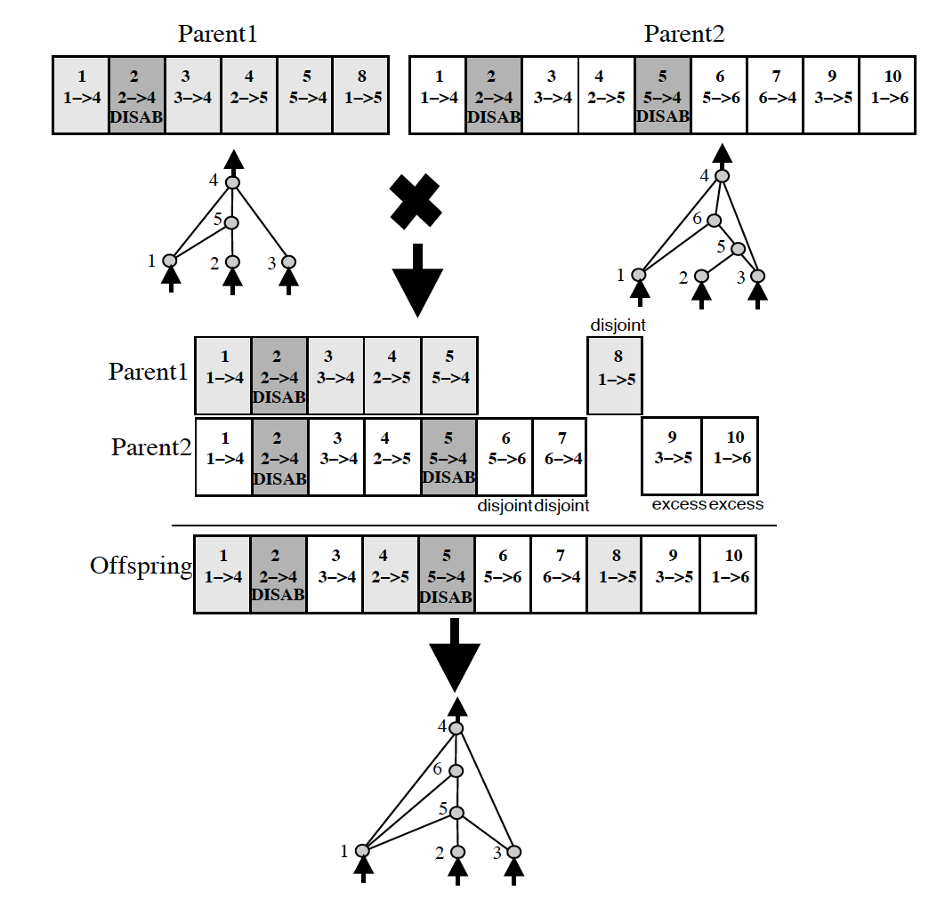
Speciation
Networks set to species
by graph-distance
Intra-species crossbreeding
http://nn.cs.utexas.edu/downloads/papers/stanley.ec02.pdf

Slide 10
Fittness
Calculated by x coordinates explored in-game
Item-pickups give bonus
Losing hp gives penalty

Slide 11
Between Game and Net

Slide 12
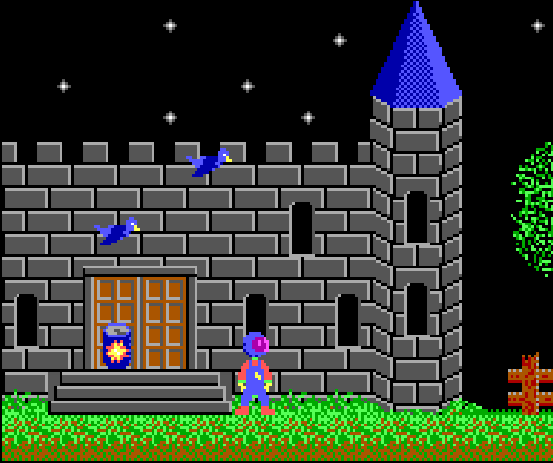


Game output
Game made of tiles
  Each tile as number
  Number shows difference: ground,hole,enemy,pickup,player
  2 outputs: view and view centred on player
2.0 2.0 5.0 2.0 2.0 2.0 2.0 2.0 2.0 2.0 2.0 2.0
2.0 2.0 2.0 2.0 2.0 2.0 2.0 2.0 2.0 2.0 2.0 2.0
2.0 2.0 2.0 2.0 2.0 2.0 2.0 2.0 2.0 2.0 2.0 2.0
2.0 2.0 0.0 2.0 2.0 2.0 2.0 2.0 2.0 2.0 2.0 2.0
2.0 2.0 1.0 2.0 2.0 4.0 2.0 2.0 2.0 2.0 2.0 2.0
3.0 3.0 3.0 3.0 3.0 4.0 2.0 2.0 2.0 2.0 2.0 2.0
3.0 3.0 3.0 3.0 3.0 3.0 3.0 3.0 3.0 3.0 3.0 3.0
3.0 3.0 3.0 3.0 3.0 3.0 3.0 3.0 3.0 3.0 3.0 3.0
3.0 3.0 3.0 3.0 3.0 3.0 3.0 3.0 3.0 3.0 3.0 3.0
3.0 3.0 3.0 3.0 3.0 3.0 3.0 3.0 3.0 3.0 3.0 3.0

Slide 13
Game input
Right, left, jump, shoot, interact, (teleport) as vector

Slide 14
Game and Net interacting

Slide 15
Results
Usually reaches fitness 120 in first 20 gens
Fitness 160 in between 30 to 300 gens
Reached 500- >1000 several times
~780 is one finished level.

Slide 16
Difficulties
Walking in diefferent directions
  At start, in new level
Shooting at all
Platforming
  Vs death, vs stuck
Enemies

Slide 17
Discussion with us
Why NEAT
  Speciation, many comparisons
Why Captain Comic
  Extreme complexity for AI benchmark
  broad field of situations
Results
  Visible Progress between generations
  Longer

Slide 18
Discussion with you
Any questions?

